Slide 1


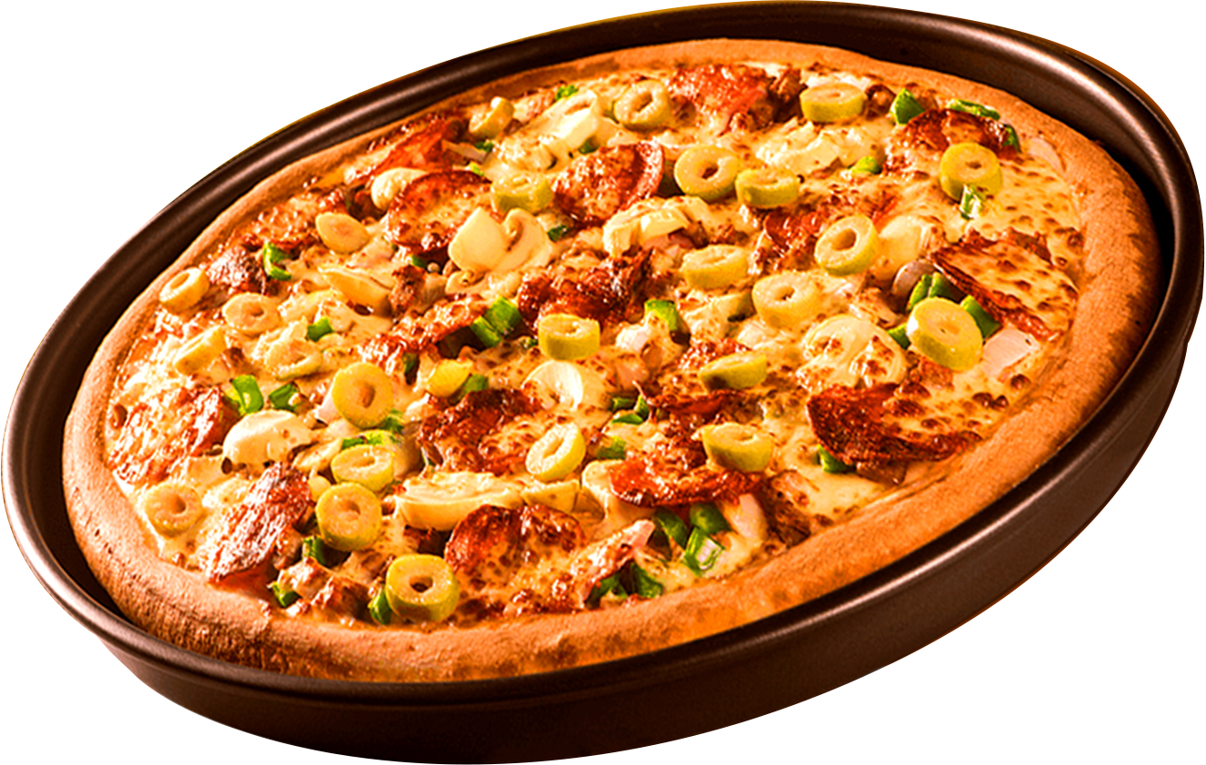
Pizza Sales Analysis Using SQL
By : Mohit Singh

Slide 2

N
INTRODUCTION
This project analyzes pizza sales data to find key insights using SQL
The dataset includes details like pizza names, categories, prices, sales quantity and revenue

Slide 3
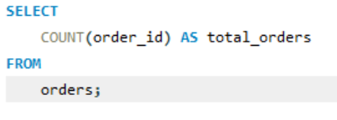
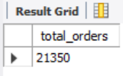
Retrieve the total number of orders placed.

Slide 4
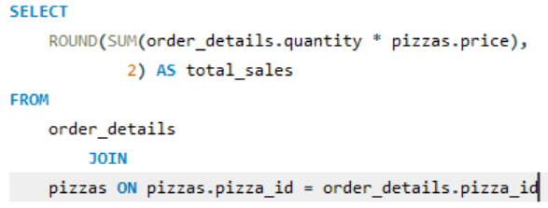
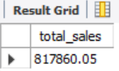
Calculate the total revenue generated from pizza sales.

Slide 5
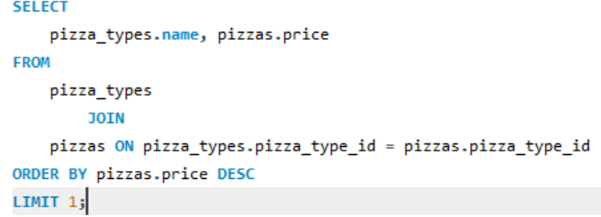
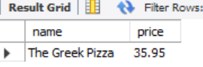
IDENTIFY THE HIGHEST-PRICED PIZZA.

Slide 6
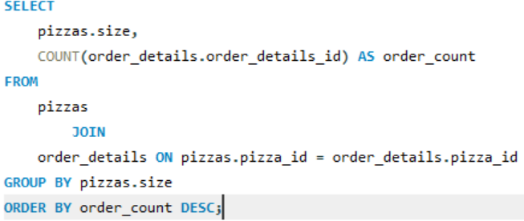
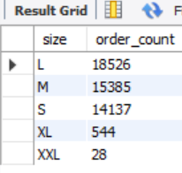
IDENTIFY THE MOST COMMON PIZZA SIZE ORDERED.

Slide 7
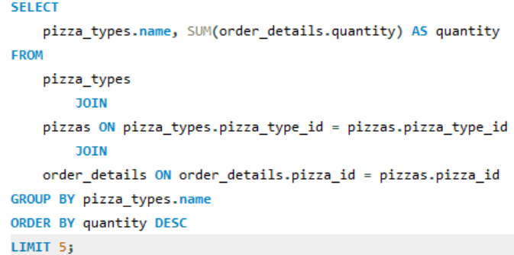
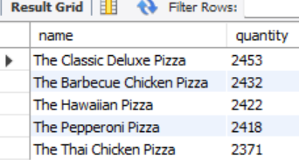
LIST THE TOP 5 MOST ORDERED PIZZA TYPES ALONG WITH THEIR QUANTITIES.

Slide 8
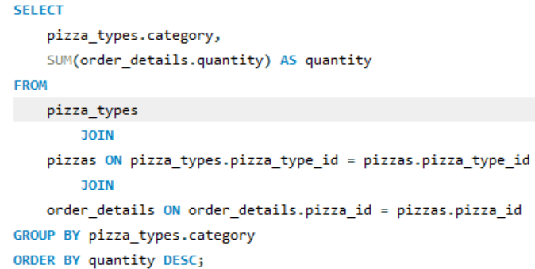
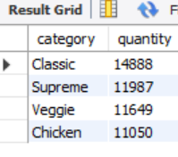
JOIN THE NECESSARY TABLES TO FIND THE TOTAL QUANTITY OF EACH PIZZA CATEGORY ORDERED

Slide 9

RECOMMENDATIONS
1- Stock more of best-selling pizzas.
2- Offer discounts on slow-moving pizzas.
3- Optimize menu based on high-revenue pizzas.

Slide 10
THANK YOU
FOR ATTENTION
Github: https://github.com/mohit26799
Linkedin: https://www.linkedin.com/in/mohit-singh-data-analyst-4362a123b/

